Slide 1

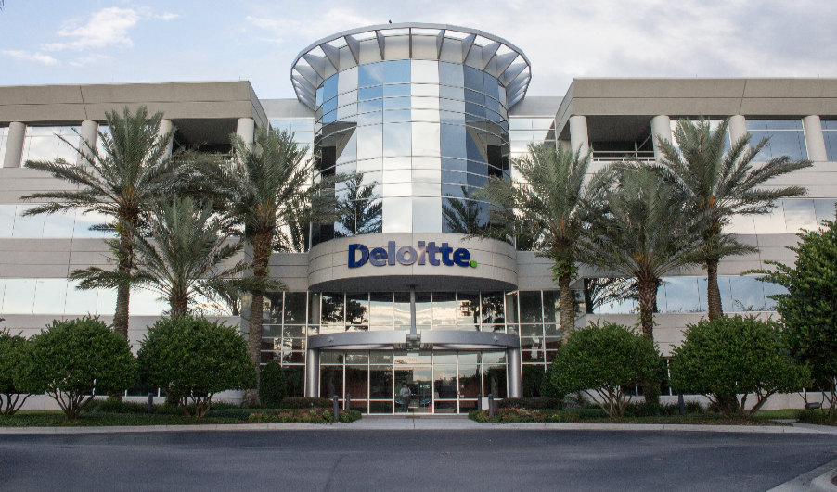
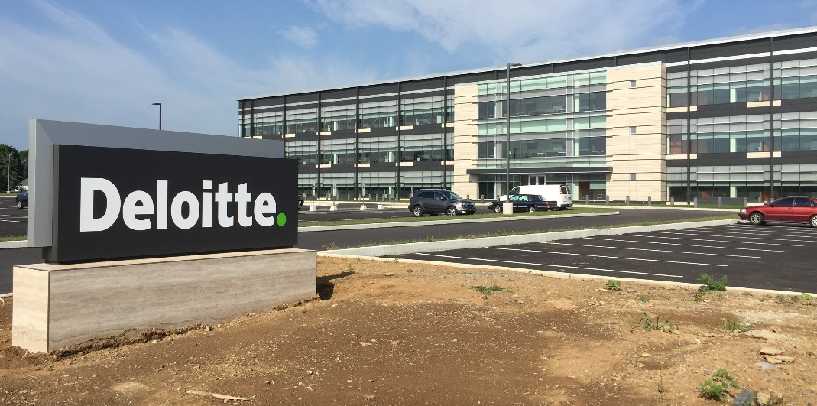

USDC Information Technology Center of Excellence (IT-CoE)
Topic: CompTIA Security+ Testing Review
Orlando, FL
Mechanicsburg, PA
Gilbert, AZ

Slide 2
Social Engineering and Password Attacks
Session 3
Security+
CompTIA Security+
Test: SYO-601
EXAM OBJECTIVES (DOMAINS)
The table below lists the domains measured by this examination and the extent to which they are represented:
Session 3
Includes Objectives from Domains 1 and 4
Objective 1.1 – Compare and contrast different types of social engineering techniques.
Objective 1.2 – Given a scenario, analyze potential indicators to determine the type of attack.
Objective 4.1 – Given a scenario, use the appropriate tool to assess organizational security.
Domain | Weight
1.0 Threats, Attacks and Vulnerabilities | 24%
2.0 Architecture and Design | 21%
3.0 Implementation | 25%
4.0 Operations and Incident Response | 16%
5.0 Governance, Risk, and Compliance | 14%
Total | 100%

Slide 3

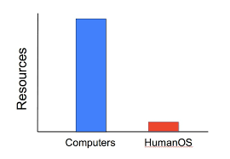
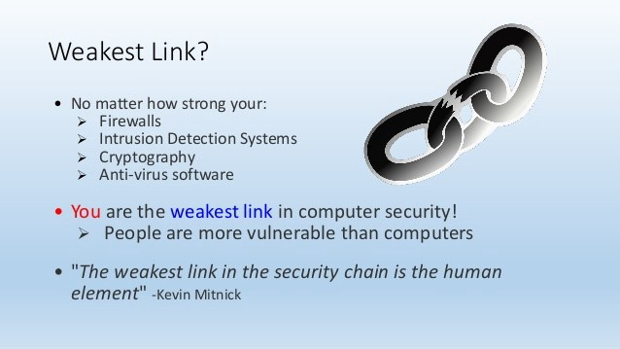
Social Engineering and Password Attacks
Session 3
Security+
Exploiting the Weakest Link in the Information Security Chain
‘Humans’ through Social Engineering
Security Resource Spending

Slide 4
Social Engineering and Password Attacks
Session 3
Security+
Terminology
Control Types – Technical, physical, or administrative measures in place to assist in resource management.
Dumpster Diving – Looking through trash for clues – often in the form of paper scraps – to find user passwords and other confidential information.
Faraday Cage – An electrically conductive wire mesh or other conductor woven into a “cage” that surrounds a room and prevents electromagnetic signals from entering or leaving the room through the walls.
Hoax – An email message warning of something that isn’t true, such as an outbreak of a new virus. A hoax can send users into a panic and cause more harm that the virus.
Perimeter Security – Security set up on the outside of the network or server to protect it.
Phishing – A form of social engineering in which you request information from someone, usually via email, and have it appear to come from a legitimate source.
Shoulder Surfing – Watching someone when they enter their username and password or sensitive data.

Slide 5
Social Engineering and Password Attacks
Session 3
Security+
Understanding Social Engineering
Principles Behind Social Engineering
(or how to be a conman with these psychological tricks)
Authority – posing as a person of authority.
Intimidation – done with threats, shouting, or guilt
Consensus - flattering and agreeing with the target
Scarcity – convincing the target there is a limited supply of something
Familiarity – being likable, with the same interests
Trust – work to gain trust, do something for the target
Urgency – convince the target that time is of the essence

Slide 6
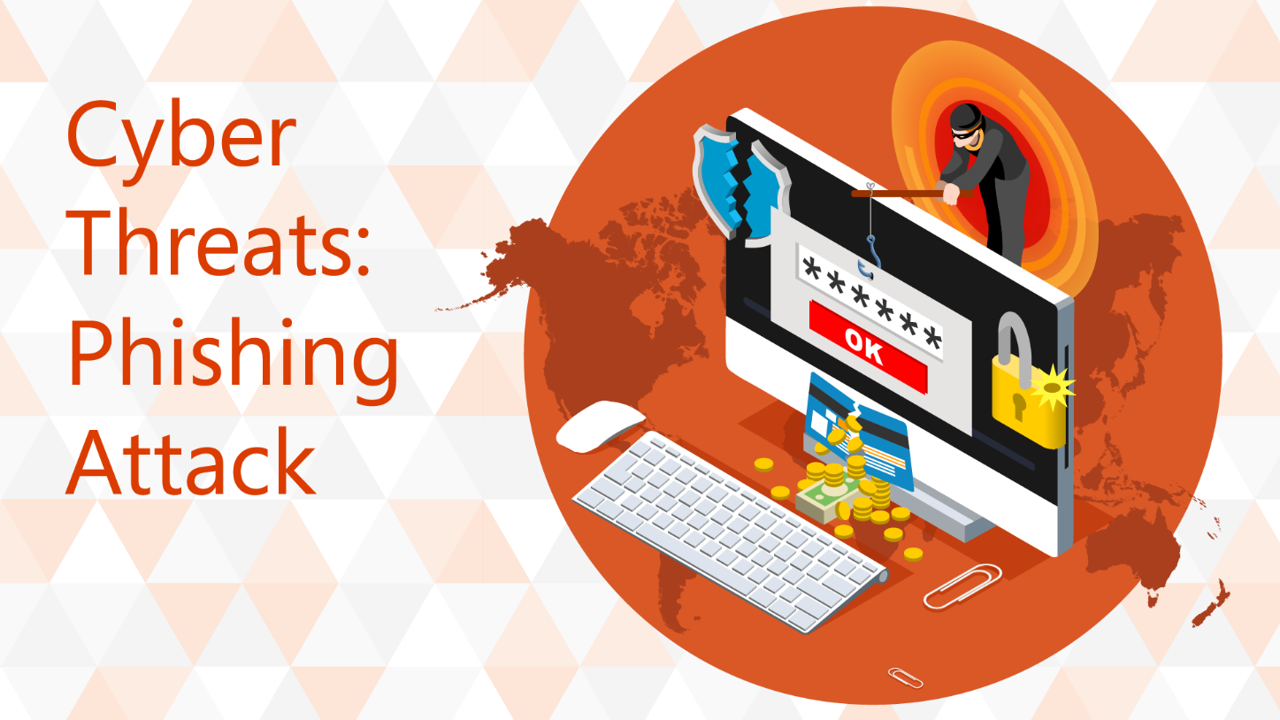
Social Engineering and Password Attacks
Session 3
Security+
Understanding Social Engineering
Phishing
To ask someone for information by having the request to appear to come from a legitimate source.
Usually done by email, the email will contain some basic information and appear to come from a legitimate source and request additional information to be entered.
Spear Phishing
Expands upon a phishing attempt, by making the information request more believable.
This is done by making the email appear to come from someone that you know to increase the chances that the requested information will be sent back in a response.

Slide 7
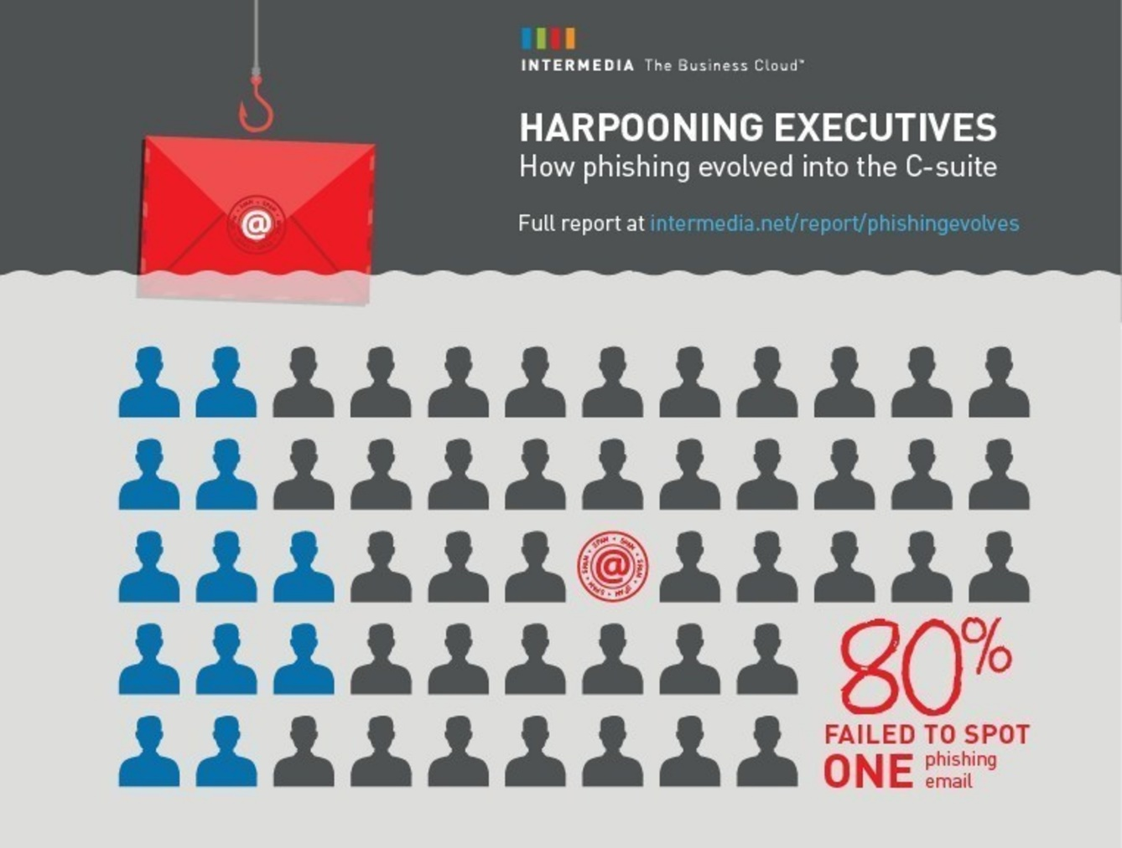
Social Engineering and Password Attacks
Session 3
Security+
Understanding Social Engineering
Whaling
This is a phishing attempt directed to a high-level person in the organization.
More time and effort is put into this phishing attempt with directed emails, with the anticipation of greater returns.
Vishing
This is a phishing attempt using Voice Over IP.
VoIP allows anyone to call over long distances without tracing or caller ID.
The scam calls can identify themselves as someone that you think that you know and try to gain confidential information.

Slide 8

Social Engineering and Password Attacks
Session 3
Security+
Understanding Social Engineering
Tailgating
A method to gain entry into an electronically secure door by following someone through the door that they have just unlocked. It is natural for people to hold a door open for someone behind them, especially if they are carrying a heavy load and appear to need help.
Sometimes referred to as piggybacking.
.

Slide 9
Social Engineering and Password Attacks
Session 3
Security+
Knowledge Check 1
An employee receives an email, which appears to be from the Chief Executive Officer (CEO), asking for a report of security credentials for all users.
Which of the following types of attack is MOST likely occurring?
A. Policy violation
B. Social engineering
C. Whaling
D. Spear phishing

Slide 10

Social Engineering and Password Attacks
Session 3
Security+
Understanding Social Engineering
Impersonation
Pretending to be someone that you are not in order to gain access to confidential information. This could just be dressing as a repair person to gain entrance into a building, or more extensive disguises.

Slide 11
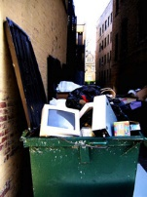
Social Engineering and Password Attacks
Session 3
Security+
Understanding Social Engineering
Dumpster Diving
This method is going through the trash of a company to find confidential information, such as username, passwords, or any other confidential information.
In many secure environments, all confidential paperwork is shredded, but most businesses don’t do this.
This can include discarded computers and parts that could be old hard drives that have not been cleansed, with sensitive information still on the hard drives.

Slide 12

Social Engineering and Password Attacks
Session 3
Security+
Understanding Social Engineering
Shoulder Surfing
Watching over someone’s shoulder as they enter their username and password into their computer, or other confidential information like a credit card number.
This is most prevalent in public places like coffee shops or airports, where people are sitting with their laptops, and people can shoulder surf as they are working.
Privacy filters on the screen can restrict the angle of viewing and decrease the success of shoulder surfing.

Slide 13
Social Engineering and Password Attacks
Session 3
Security+
Knowledge Check 2
Anne, the Chief Executive Officer (CEO), has reported that she is getting multiple telephone calls from someone claiming to be from the helpdesk. The caller is asking to verify her network authentication credentials because her computer is broadcasting across the network.
This is MOST likely which of the following types of attacks?
A. Vishing
B. Impersonation
C. Spim
D. Scareware

Slide 14
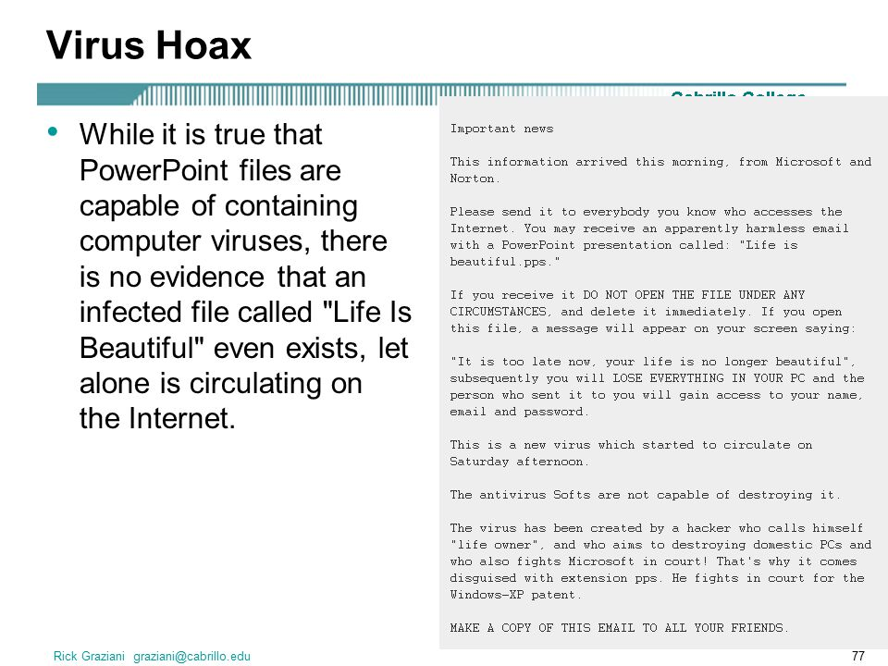
Social Engineering and Password Attacks
Session 3
Security+
Understanding Social Engineering
Hoax
An email hoax concerning a virus or something else that is not true but is meant to generate anxiety or actions to those that receive the hoax.
All notices of new viruses can be validated through the US CERT site. (www.us-cert.gov)
A lot of non-computer related hoaxes are passed around the internet, and www.snopes.com is the most popular site to validate/invalidate hoaxes.

Slide 15
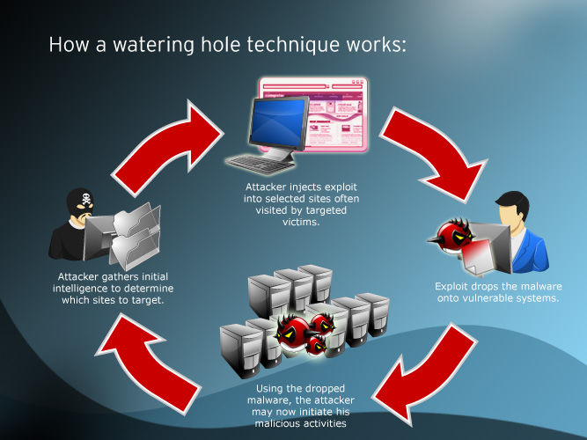
Social Engineering and Password Attacks
Session 3
Security+
Understanding Social Engineering
Watering Hole Attack
This attack method is to attack and infect a partner network of the target network, and when the target network connects to the partner network, then the infection is passed on from there.
This is the attack vector when the security of the target network is strong, and the attacker has to find a weak link partner network.
Key point – make sure that business partners that can connect to your network have the same level of high security as your network. The partner’s network can be the weakest link in security.

Slide 16
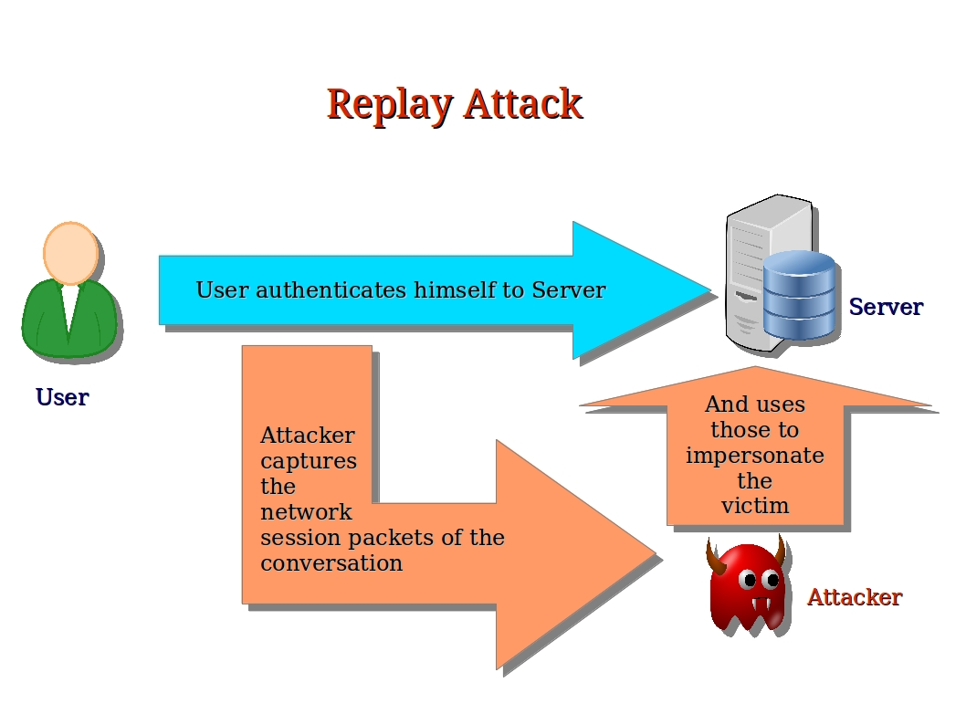
Social Engineering and Password Attacks
Session 3
Security+
Password Attacks
Replay Attack
In this scenario, the attack can sniff the network packets with a tool such as Wireshark, and capture network packets that contain authentication data such as certificates.
This data will then be used to send back to a server to attempt to get authenticated with the captured authentication packet. If the attack is successful, the attacker will have all of the rights and privileges from the original user.
If the certificate is expired, the attack will be rejected. An entry in a security log will be made, and system administrators should check these logs regularly.

Slide 17
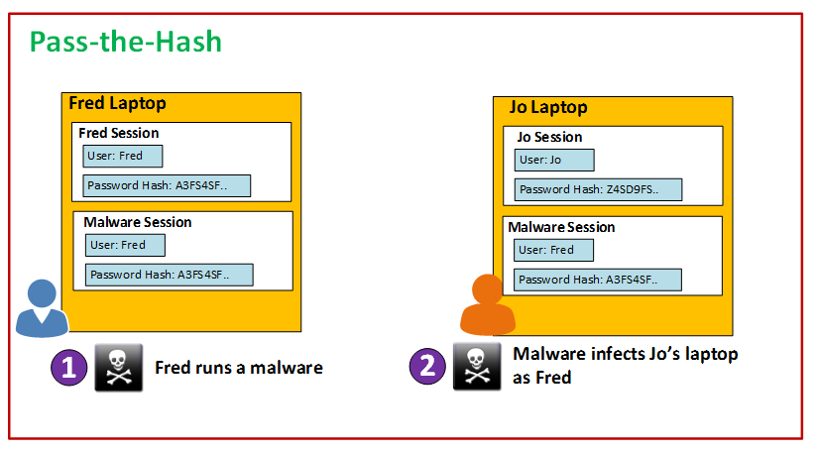
Social Engineering and Password Attacks
Session 3
Security+
Password Attacks
Pass the Hash
This is a weakness in Windows NTLM and LanMan where a password hash can be used, along with a valid username, to authenticate to any remote server.
The password hash can be found in the Windows SAM file or captured in a network capture.

Slide 18
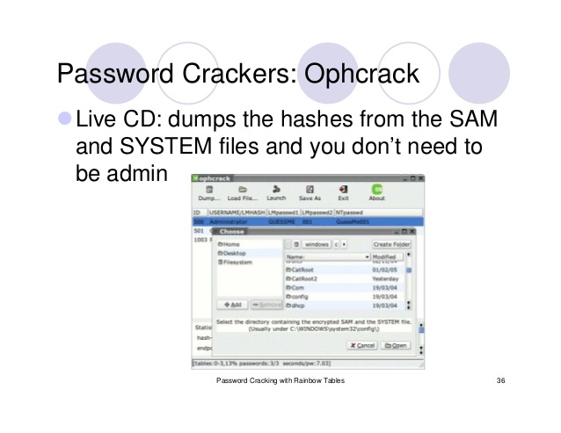
Social Engineering and Password Attacks
Session 3
Security+
Password Attacks
Rainbow Table Attack
Rainbow Table is a database table of all possible hashes computed in advance. Based on plaintext lengths of 4, 5, 7 letter, etc. for an original plaintext.
Searching the table would give a match for a password hash value.
Tools like OphCrack use rainbow tables to crack a password.
Salting is a countermeasure to rainbow tables. This will add random bits to the beginning or end of a hash to make the hash variable and defeat the rainbow table attack.
Hashed passwords are kept in the SAM (Security Account Manager) file in a Windows operating system.

Slide 19
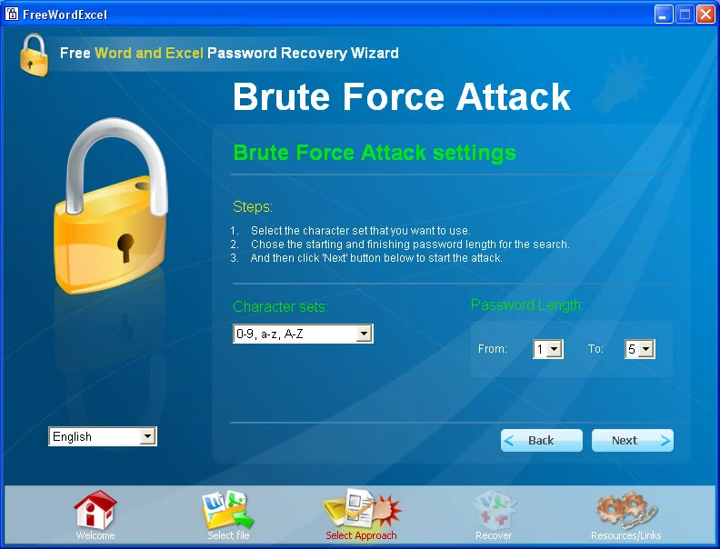
Social Engineering and Password Attacks
Session 3
Security+
Password Attacks
Brute-force Attack – Iterate through a list of common passwords and variations to find one that works.
Dictionary Attack – To determine a password, words and combinations from a dictionary are tested.
.

Slide 20
Social Engineering and Password Attacks
Session 3
Security+
Knowledge Check 3
A company’s user lockout policy is enabled after five unsuccessful login attempts. The help desk notices a user is repeatedly locked out over the course of a workweek.
Upon contacting the user, the help desk discovers the user is on vacation and does not have network access.
Which of the following types of attacks are MOST likely occurring? (Select two.)
A. Replay
B. Rainbow tables
C. Brute force
D. Pass the hash
E. Dictionary

Slide 21
Social Engineering and Password Attacks
Session 3
Security+
Thank You!!
Send questions and slide deck requests to:
Jim Reeves
Security+, CASP+,CySA+, CISSP, ITILv3, CTT+
MCSE, MCSD, MCT
jireeves@Deloitte.com

